Slide 1
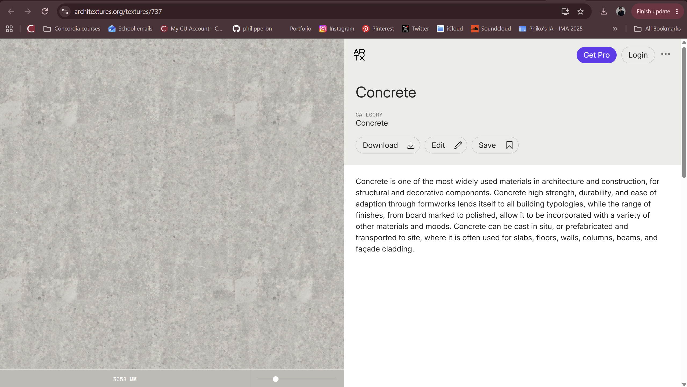
Concrete Site
by Philippe Beauchemin

Slide 2
Concept
The viewer is prompted to use their personal device to access the project; in doing so, they unconsciously provide information to be extracted.
The project displays an image of a concrete wall, procedurally generated, which is altered by the viewer’s presence on the virtual site. The concrete wall reacts to various components of the viewer’s data, changing its visual qualities accordingly.
As viewers join the site, the concrete wall changes over time and informs its viewers of these changes through a timeline.

Slide 3
As each aspect of the visitor’s data is mapped onto a specific visual quality of the image, Concrete Site translates how this data correlates to the viewer’s material conditions in the outside world. Concrete Site critiques the materiality of concrete in relation to its socio-cultural and historical context, while also offering a critique of class and e-tourism in the age of surveillance capitalism.
As a final addition to the experience, if the viewer wishes to own a specific iteration of the concrete wall, they are offered the option to print out the image, labelled with the time and date it was affected by a visitor as well as the parameters that led to the iteration (mimicking a Pantone swatch).

Slide 4
Algorithmic Approach
I plan to use the techniques of procedural texture generation, procedural rhetoric and emergent narrative.
{Procedural texture generation} The visual component of the piece, running in real-time over a long period of time and reacting to users’ data as well as API data
{Procedural rhetoric} Pessimistic notions of concrete as a material (Criticizing its relationship to power, wealth and control)
{Emergent narrative} The user explores the various iterations of the wall over time to understand the different visual outcomes
The project will heavily rely on data extraction and mappings between:
a user’s device (model, browser, location),
APIs (such as weather at that location), and
the project, acting as both a client and a server for data exchanged over a network (which I will learn in CART 351: Networks and Navigation)

Slide 5
Context and Influences
My project was first strongly influenced by Adam Basanta’s All We’d Ever Need Is One Another.
print
black box algorithm
iterative process (procedural generation)
computer vision and machine learning
critique of the valuation of art in today’s art world
“meta” aspect:
  creation of a “valuable” product
  quality of the print, context, parts of the process made visible, and parts hidden = compelling final product while self-critiquing the very process it was made in
Basanta, Adam. All We’d Ever Need is One Another. 2018. Mixed media installation. https://adambasanta.com/allwedeverneed.php
Notes:
Start at 58s

Slide 6
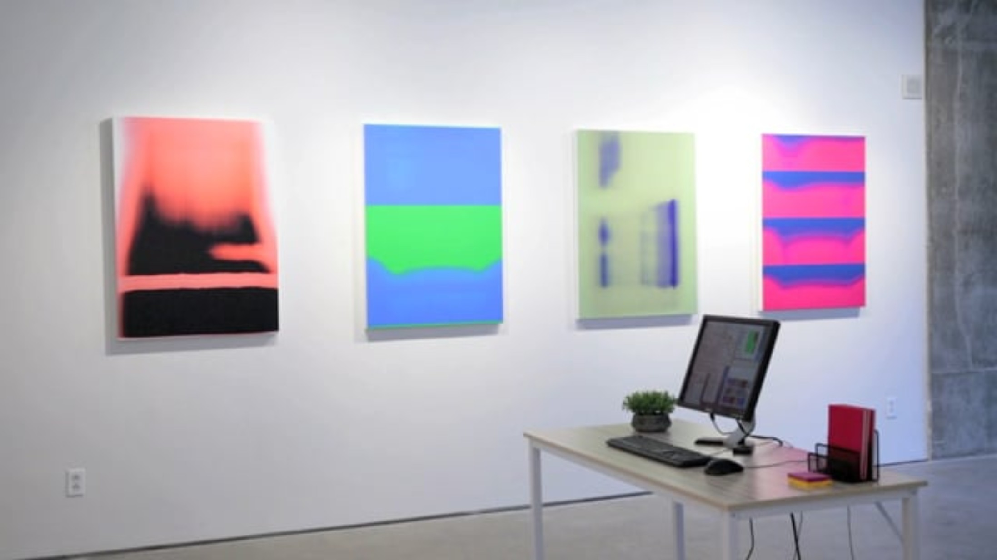

Slide 7
Artificial removal of ownership of the means of productions: art generator with no master, only an arbitrary model that allows for the commodification of certain iterations
Critical Theory: Theodor Adorno and Max Horkheimer critique the production of art in the age of modernity in Dialectic of Enlightenment:
“Art for the masses has destroyed the dream but still conforms to the tenets of that dreaming idealism… Everything derives from consciousness: … in mass art, from the consciousness of the production team.”
In this context, my piece critiques what is considered art, using the banality of a concrete wall to communicate anti-capitalist ideals, reframing materiality as being politically charged.
Adorno and Horkheimer, Dialectic of Enlightenment, trans. John Cumming (Verso, 1997; original text 1944), 125.

Slide 8
Scope and Feasibility
procedural texture generation algorithms
  I have never written one but I have written iterative algorithms before
  I am not sure how computationally expensive it will be to keep the algorithm running over a long period of time.
data extraction
  I understand arrays and how to store data in JavaScript
  I will need to better understand how to extract data and manipulate it (from users and APIs)

Slide 9
Visual / Aesthetic Direction
brutalist/minimalist
banal, uninteresting, maybe a bit intriguing
hyperrealistic concrete wall image
uncanny synthetic image
white background
timeline for users to hover over as well as navigate to visualize the evolution of the texture over time
layering of information over the image when it is printed
  refined but busy, odd and absurd, evoking the codes of commodification

Slide 10
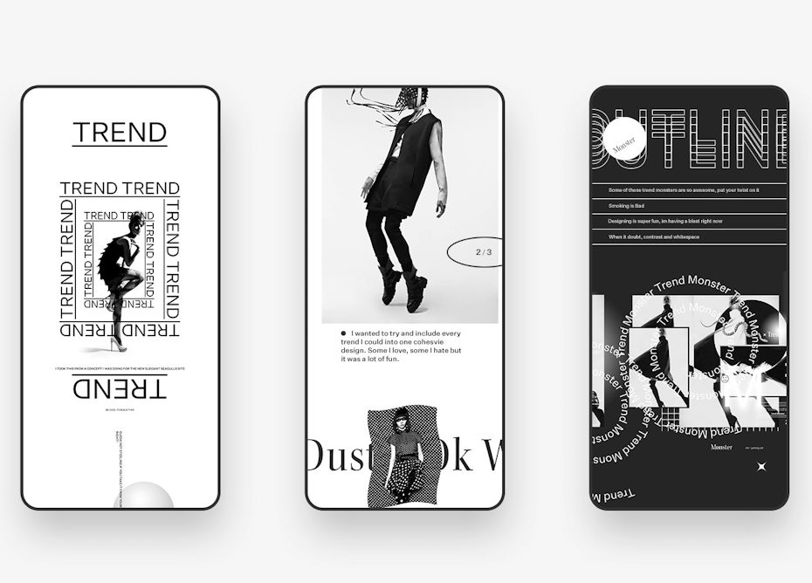
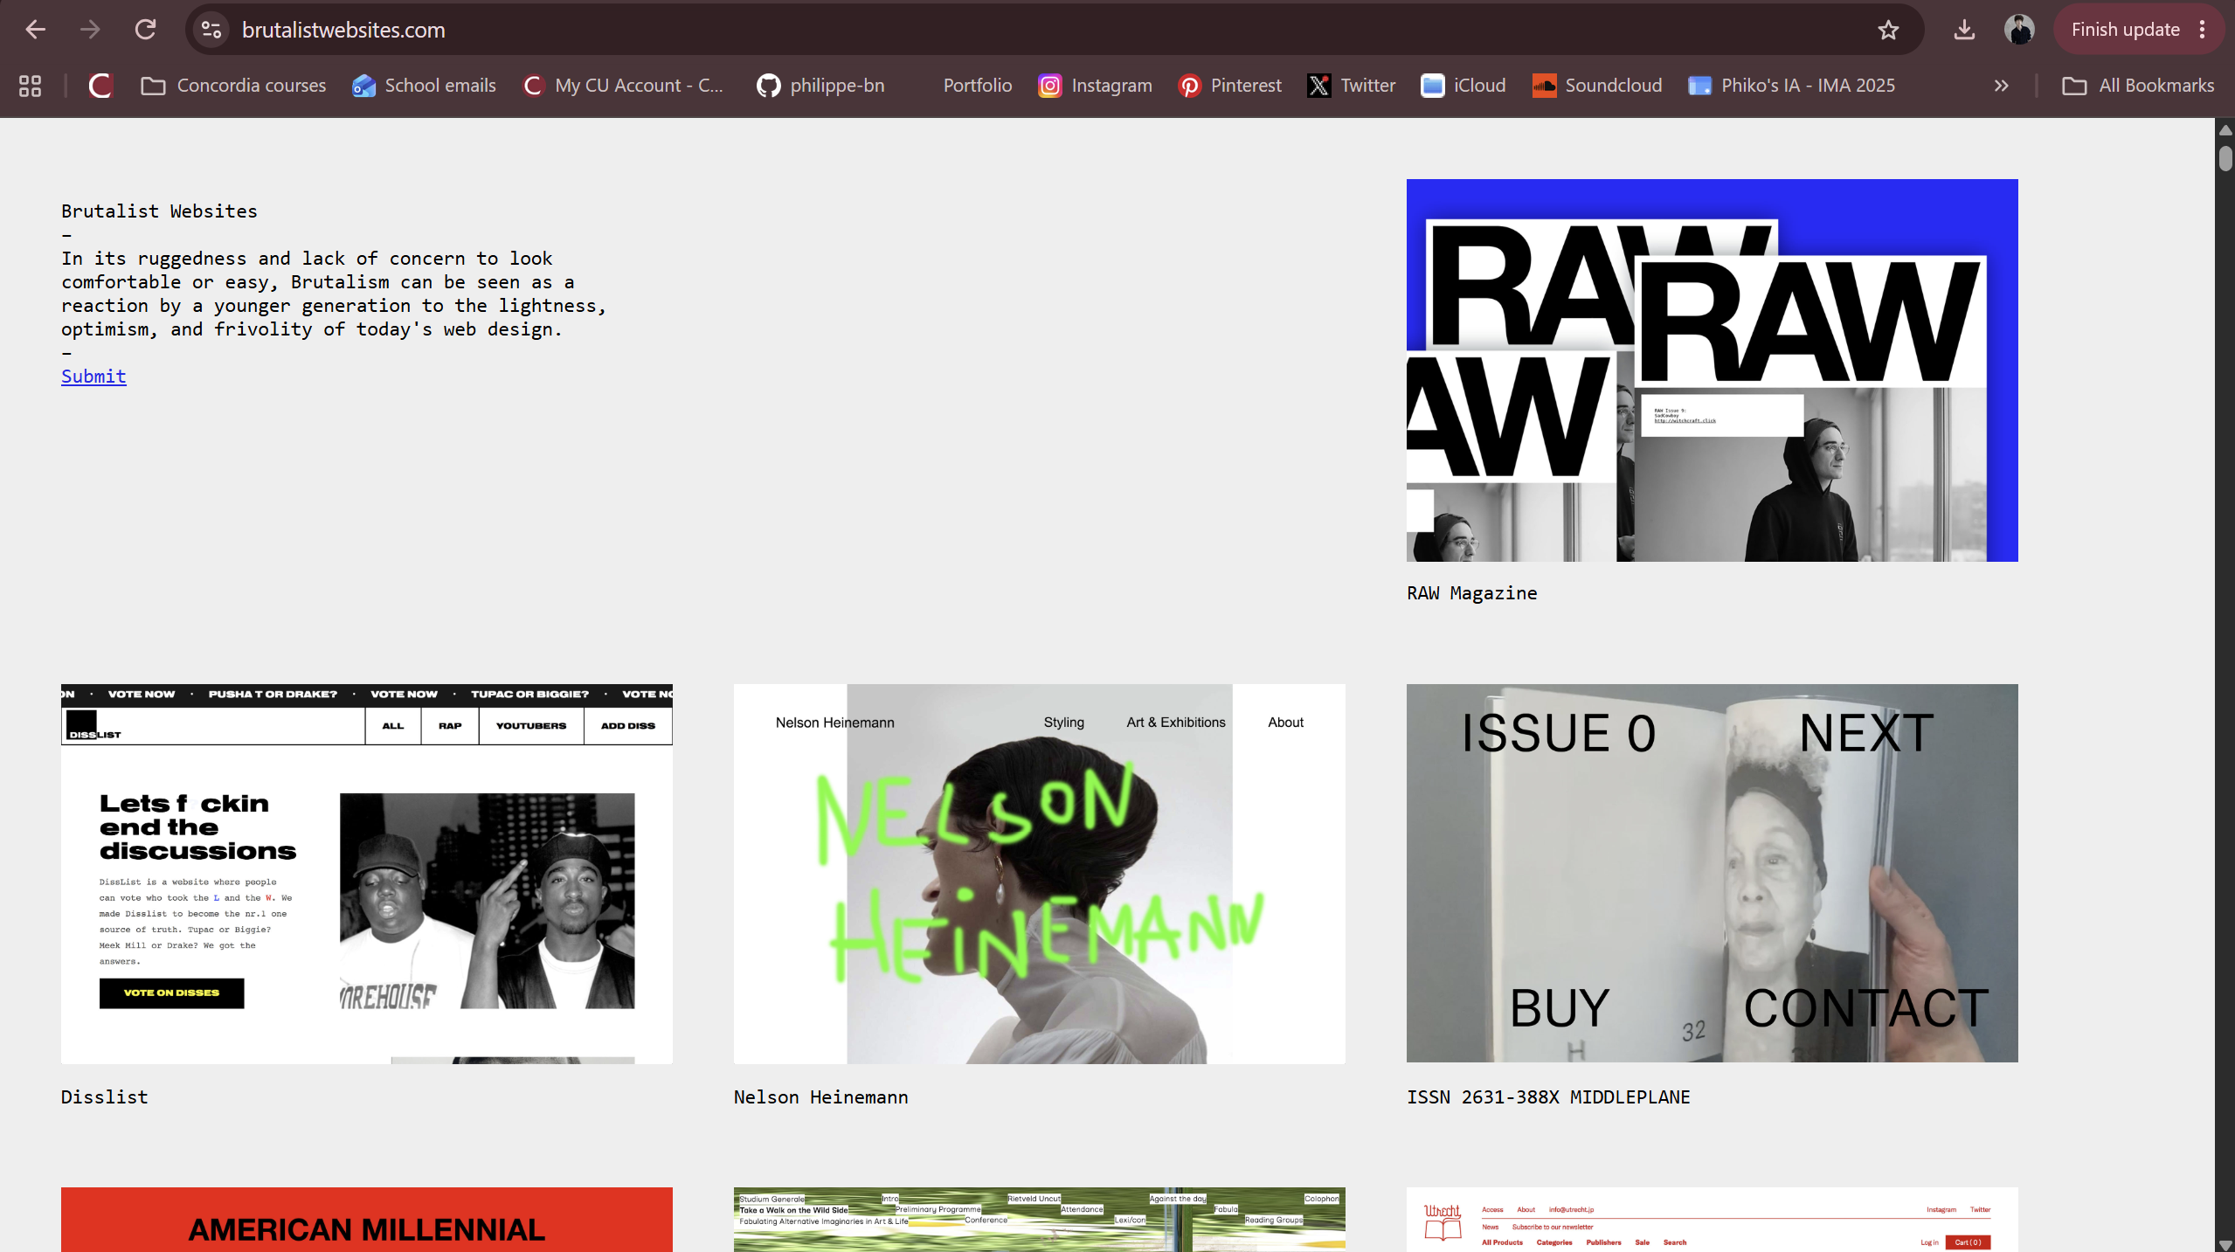
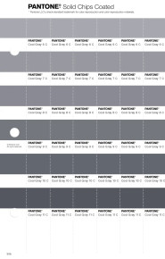
1.
2.
Brutalism: The term comes from the French béton brut or “raw concrete,” and like it’s namesake, the style is stark, honest and captivating.
3.
4.
5.
1, 2. Levanier, Johnny. “Brutalism in design: its history and evolution in modern websites.” 99designs by Vista. 2021.
https://99designs.com/blog/design-history-movements/brutalism/ (Picture credit: Design by Ben Johnson via Dribbble)

